Slide 1
Hackathon - Energy Grid
S63-1
Jursley
Nick
Vincent
Faruk
Maarten

Slide 2
Agenda
Approach
Structure
Demo
Questions?

Slide 3





Approach
Producers
Frontend

Slide 4




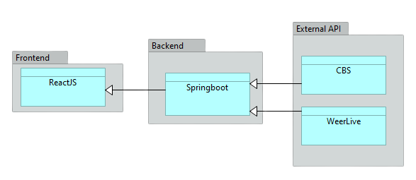
Structure
Frontend (ReactJS)
Backend (Java - Springboot)
Weerlive API
CBS Opendata Statline - Energy production data for each energy type

Slide 5
Demo time!

Slide 6
Any questions?

